Slide 1



郑凯文
2018 - 10 - 19
Reachability Queries in Public Transport Networks
Notes:
EDBT / ICDT研讨会主席
Nikolaus Augsten，奥地利萨尔茨堡大学
第28届地理标志 - 数据库基础研讨会

Slide 2
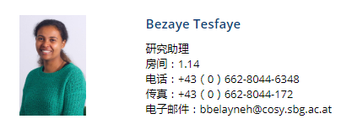


Notes:
数据库研究小组是奥地利萨尔茨堡大学计算机科学系的一部分。我们的研究兴趣包括数据库和信息系统中以数据为中心的应用，特别关注大数据集合上的相似性搜索查询，例如，字符串和树的近似匹配，距离计算的有效索引以及top-k查询。其他研究领域包括分布式框架（如MapReduce）和地理信息系统中的查询的负载平衡算法。研究结果是具有性能保证的新算法，在激励应用上实施和评估

Slide 3
OUTLINE
1
Introduction
2
Exist Approach
3
Our Approach
4
Conclusion

Slide 4


Introduction
Background
Public Transport Networks

Slide 5
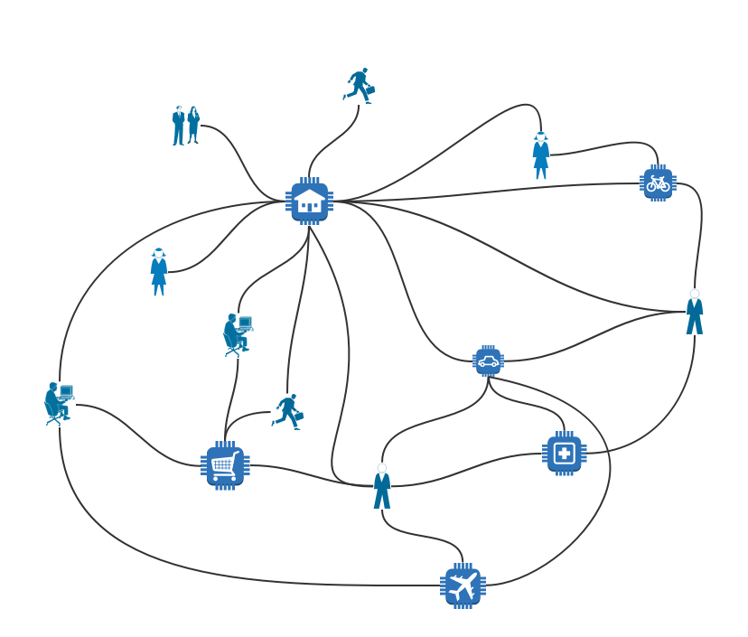
Introduction
POI
A reachability query retrieves all points of interest
return all students that
can reach their school at 8am within 10 minutes either on foot or via public transport”

Slide 6
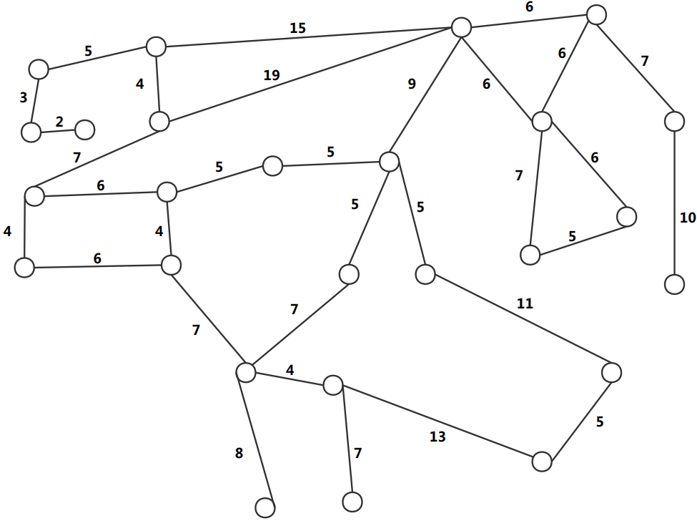
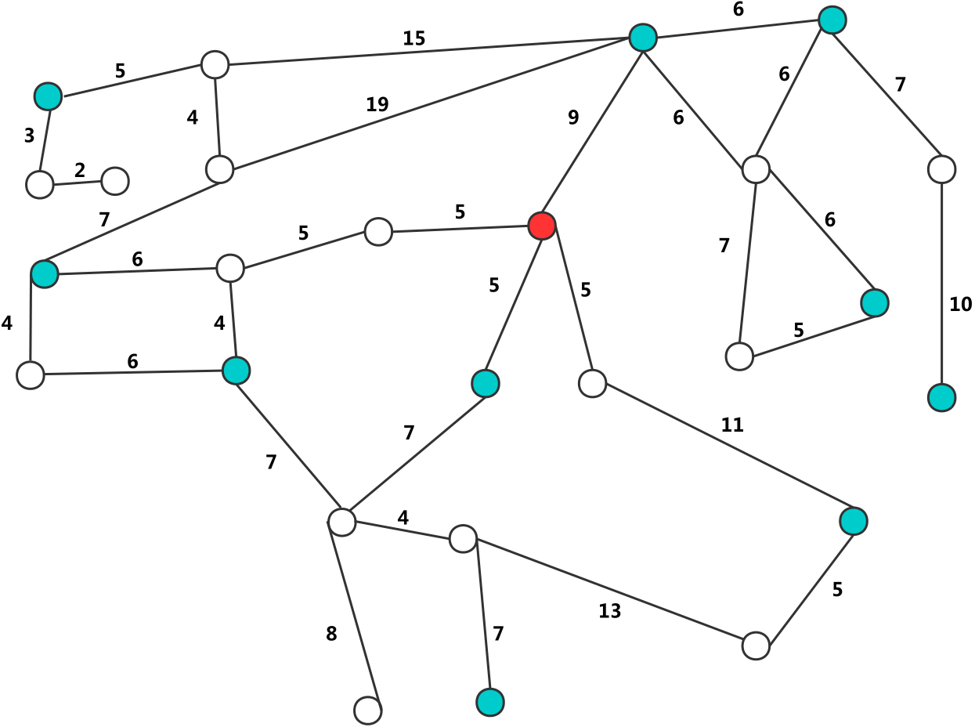

Preliminaries
Definition
Public Transport Networks
G = (V , E , P(V), T(E) , t)
is a directed graph
(but first ,we think about
undirected graph)
Query:
cost budget ∆t
a set of points of interest P
a query point q in G
d_{t}(u,v) is the minimum cost of u→v
query time t
5/34
t= 8:00am

Slide 7
OUTLINE
1
Introduction
2
Exist Approach
3
Our Approach
4
Conclusion

Slide 8
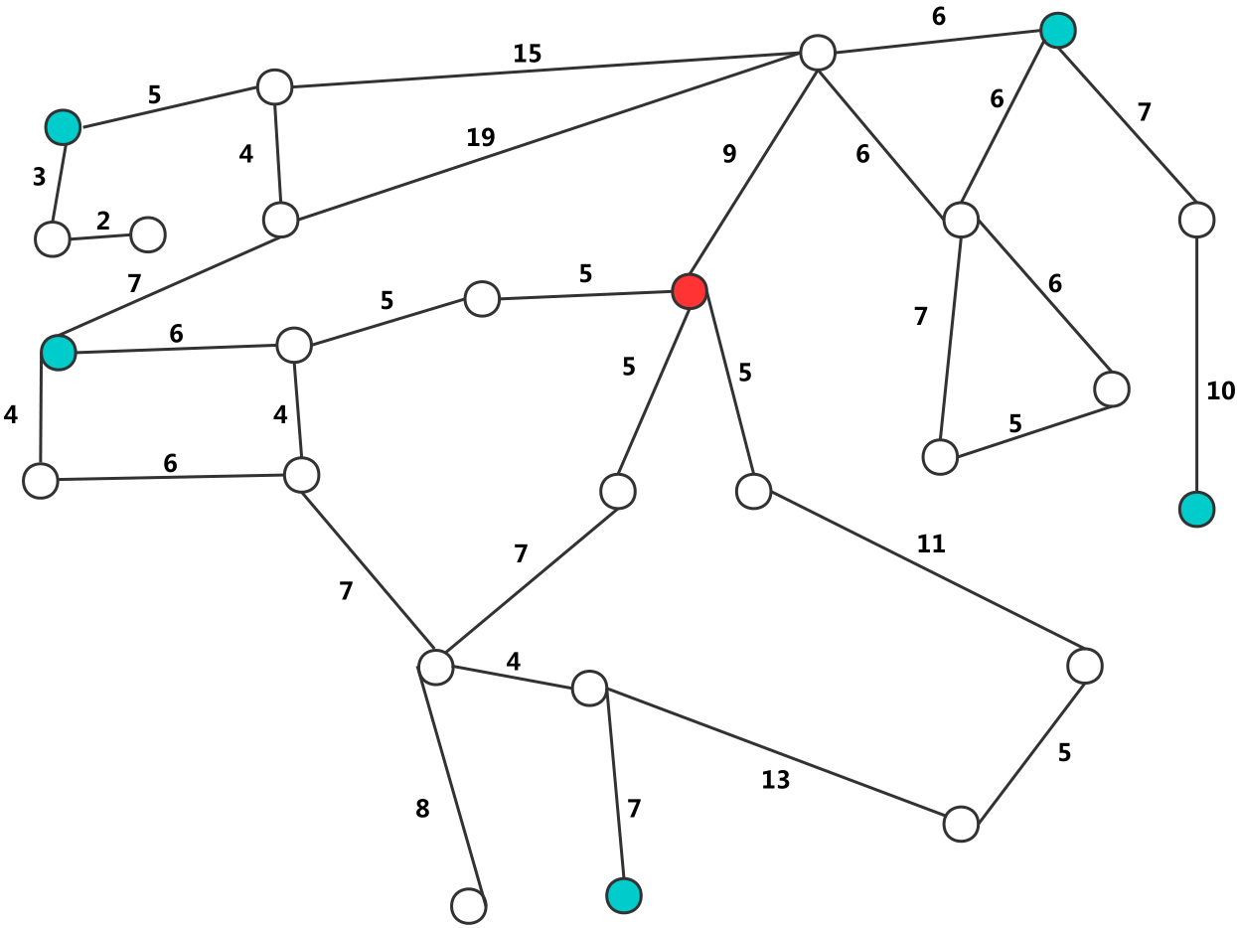
Exist Approach
(a) compute the subset that reaches the query point and intersect with the POI set
Problem: beneficial for network areas with many result points,but the algorithm must also expand network areas that do not contain any result
7/34
Notes:
通过按需遍历回答
非常高的查询延迟

Slide 9
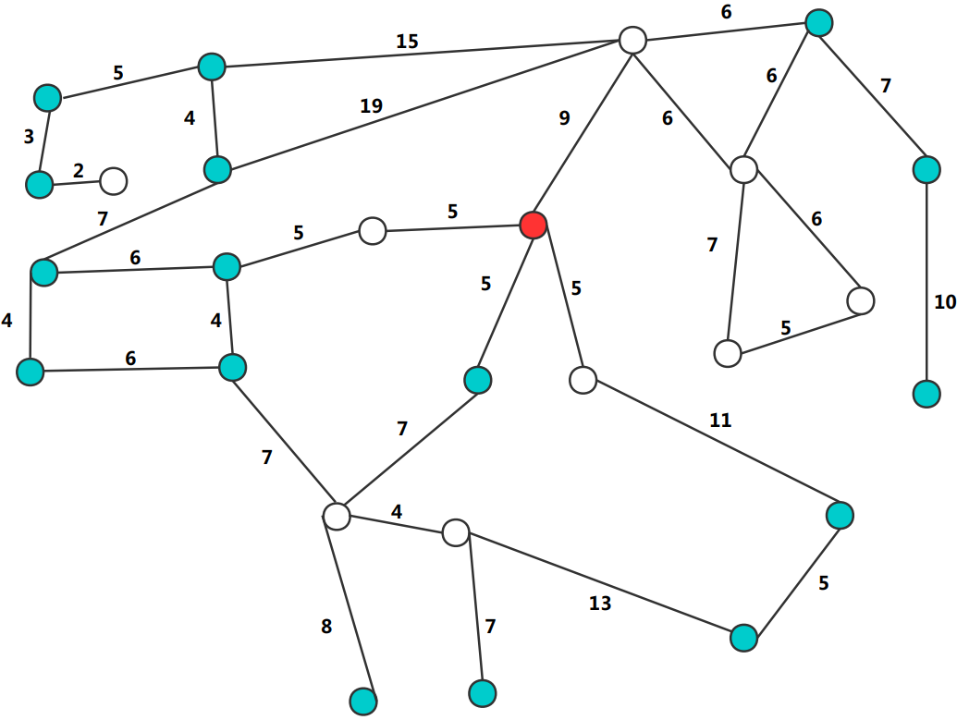
Exist Approach
(b) compute the shortest path between each POI and the query point, and retain those POIs that are close enough.
Problem: depends on the overall number of POIs and may require a large number of shortest path computations even for small result sizes
7/34
Notes:
通过按需遍历回答
非常高的查询延迟

Slide 10
Exist Approach
(c) pre-compute the shortest path
between each two vertexs ,and storage the transitive closure
road networks
Problem:
pre-compute (and maintain) cost high time.
storage overhead too large ,and bad for scalability.
7/34
Notes:
通过按需遍历回答
非常高的查询延迟

Slide 11
Exist Approach
Another Problem
80
TIME
30
d_{t}(u,v) is the minimum cost
40
d_{t}(u,v) = 16
d_{t}(u,v) = 5+7+4+13+5=34
5/34

Slide 12
Preliminaries
Review
Problem:
either restricted to road networks (don't think about time) or do not scale to large networks
Query:
cost budget ∆t
a set of points of interest P
a query point q in G
d_{t}(u,v) is the minimum cost of u→v
query time t
5/34

Slide 13
OUTLINE
1
Introduction
2
Exist Approach
3
Our Approach
4
Conclusion

Slide 14
Our Approach
network partitions and
local precomputations within each partition.
improve
query processing efficiency
and
Scalability
11/34
Notes:
选择性快照索引与渐进式解决方案细化
平衡查询处理效率和索引成本

Slide 15
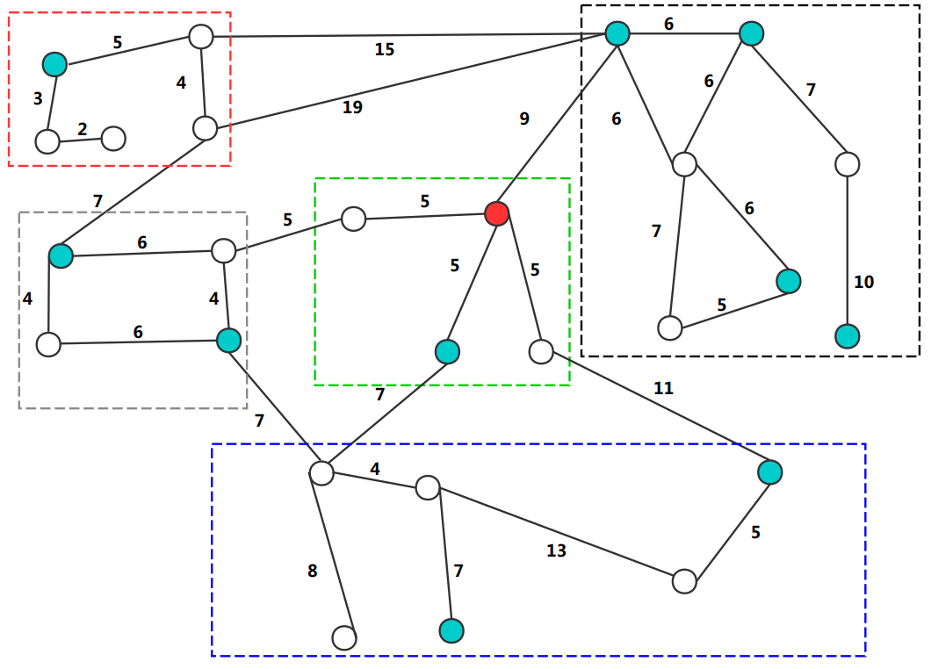
Our Approach
Main Idea：
①partition the graph into n cells；( A cell C is a connected
subgraph)
② compute cost upper bounds and lower bounds between
specific pairs of nodes
12/34
Notes:
选择性快照索引与渐进式解决方案细化
主要思想：
①仅索引部分快照;
②查找最接近目标快照的索引快照;
③检查索引快照中v＆w之间的可达性;
④分析索引快照和目标快照之间编辑序列对目标顶点可达性的影响;

Slide 16
Our Approach
10
14
23
14
10
5
16
14
10
10
B is a set of border nodes
add virtual nodes
add edge of virtual node
between border node
22
30

Slide 17
Our Approach
B1
10
4
14
4
23
6
B1
B1
10
5
4
14
5
5
16
4
14
5
10
4
B2
10
B2
5
B3
4
5
in every cell C_{i}
compute the lower bounds
between B_{i} and virtual nodes
B1
22
30
Notes:
选择性快照索引与渐进式解决方案细化
主要思想：
①仅索引部分快照;
②查找最接近目标快照的索引快照;
③检查索引快照中v＆w之间的可达性;
④分析索引快照和目标快照之间编辑序列对目标顶点可达性的影响;

Slide 18
Our Approach
B1
Initialization of Expansion
10
4
14
4
23
6
Q( q , ∆t = 15 , P )
B1
B1
10
5
B_{E}={B1,B1,B2,B2,B1,B3,B1}
4
14
5
5
16
4
14
5
10
4
B2
10
B2
5
B3
4
5
B1
22
30

Slide 19
Our Approach
B1
Upper Bound Expansion
10
4
14
4
23
Q( q , ∆t = 15 , P )
6
B1
B_{E}={B1,B1,B2,B2,B1,B3,B1}
B1
4
14
10
5
5
16
4
5
14
5
10
4
B2
10
B2
5
B3
Ru={V}
Ru={V,B1,B2,B1}
Ru={V,B1,B2,B1,B1}
Ru={V,B1,B2}
4
5
B1
22
30
Notes:
选择性快照索引与渐进式解决方案细化
主要思想：
①仅索引部分快照;
②查找最接近目标快照的索引快照;
③检查索引快照中v＆w之间的可达性;
④分析索引快照和目标快照之间编辑序列对目标顶点可达性的影响;

Slide 20
Our Approach
B1
Lower Bound Expansion
10
4
14
4
23
Q( q , ∆t = 15 , P )
6
Ru={V,B1,B2,B1,B1}
B1
B1
10
5
B_{E}={B1,B1,B2,B2,B1,B3,B1}
4
14
5
5
16
4
14
5
10
4
B2
10
B2
5
B3
Rl={V}
Rl={V,V}
4
5
B1
22
30
Notes:
选择性快照索引与渐进式解决方案细化
主要思想：
①仅索引部分快照;
②查找最接近目标快照的索引快照;
③检查索引快照中v＆w之间的可达性;
④分析索引快照和目标快照之间编辑序列对目标顶点可达性的影响;

Slide 21
Our Approach
Candidate Verification
10
4
14
4
Q( q , ∆t = 15 , P )
23
6
Ru={V,B1,B2,B1,B1}
4
14
10
5
5
Rl={V,V}
16
4
5
14
5
10
4
10
5
use A* apporch to compute the result
(a efficient algorithm of short path )
4
5
22
30
Notes:
选择性快照索引与渐进式解决方案细化
主要思想：
①仅索引部分快照;
②查找最接近目标快照的索引快照;
③检查索引快照中v＆w之间的可达性;
④分析索引快照和目标快照之间编辑序列对目标顶点可达性的影响;

Slide 22
Our Approach
20
Extending the Algorithm
10
4
14
4
23
①Directed Graphs
compute two upper and lower bounds for each relevant node pair (one for each direction)
6
4
16
10
5
5
16
4
5
16
5
10
4
10
5
4
5
22
30
Notes:
选择性快照索引与渐进式解决方案细化
主要思想：
①仅索引部分快照;
②查找最接近目标快照的索引快照;
③检查索引快照中v＆w之间的可达性;
④分析索引快照和目标快照之间编辑序列对目标顶点可达性的影响;

Slide 23
Our Approach
Extending the Algorithm
10
4
14
4
23
②Effective Partitioning Strategy
• the number of border nodes per cell should be small;
• the overall number of border edges should be small;
• the difference between the upper and lower bounds of
a cell should be small;
• all nodes in a cell should be pairwise reachable;
• different cells should be of similar size
6
4
16
10
5
5
16
4
5
16
5
10
4
10
5
4
5
22
30
Notes:
我们确定了一组有效分区应满足的属性：
•每个小区的边界节点数应该很小;
•边界边缘的总数应该很小;
•细胞上限和下限之间的差异应该很小;
•单元中的所有节点应成对可达;
•不同的细胞应具有相似的大小（即，就上限遍历时间而言是均质的）。

Slide 24
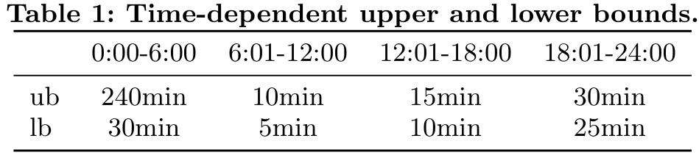
Our Approach
Extending the Algorithm
80
③Time-Dependent Bounds
split the schedule into intervals and compute a different bound for each interval
13
10
30
40
Notes:
我们确定了一组有效分区应满足的属性：
•每个小区的边界节点数应该很小;
•边界边缘的总数应该很小;
•细胞上限和下限之间的差异应该很小;
•单元中的所有节点应成对可达;
•不同的细胞应具有相似的大小（即，就上限遍历时间而言是均质的）。

Slide 25
OUTLINE
1
Introduction
2
Exist Approach
3
Our Approach
4
Conclusion

Slide 26
Conclusion
This paper propose a technique to compute reachability queries in public transportation networks by partitioning the graph into cells and use a novel expansion technique based on upper and lower bounds.
Different from the Dijkstra-like expansion techniques used in related work. This paper use precomputation and expect to reduce the number of shortest path computations for reachability queries.
33/34
Notes:
对于许多现代应用程序来说，在时间推移层次结构中对可达性查询进行高效且可扩展的处理非常重要。
在本文中，我们提出了一个可调，时间和空间有效的框架，称为SCISSOR，用于测试TEH任何给定快照上给定顶点对之间的可达性。
SCISSOR背后的主要思想是有选择地索引TEH快照的子集，并使用这些快照索引来回应TEH的所有快照上的可达性查询。

Slide 27
Future Work
Plan to develop an effective partitioning algorithm.
Plan to generalize our solution for public transport networks to multimodal networks, which also include road and pedestrian edges.
33/34
Notes:
对于许多现代应用程序来说，在时间推移层次结构中对可达性查询进行高效且可扩展的处理非常重要。
在本文中，我们提出了一个可调，时间和空间有效的框架，称为SCISSOR，用于测试TEH任何给定快照上给定顶点对之间的可达性。
SCISSOR背后的主要思想是有选择地索引TEH快照的子集，并使用这些快照索引来回应TEH的所有快照上的可达性查询。

Slide 28
Thank You!

Slide 29
2
2.8
2+1

